Slide 1
chapter 8 Tree-Based Methods

Slide 2
Main content
Single classifier
Classification and Regression Tree
Ensemble method
Bagging, Radom Forest and Boosting

Slide 3
8.1 The Basics of Decision Trees
In this chapter, we describe tree-based methods for regression and classification. These involve stratifying or segmenting the predictor space into a number of simple regions.
In order to make a prediction for a given observation, we typically use the mean or the mode of the training observations in the region to which it belongs.
Since the set of splitting rules used to segment the predictor space can be summarized in a tree, these types of approaches are known as decision tree methods.

Slide 4
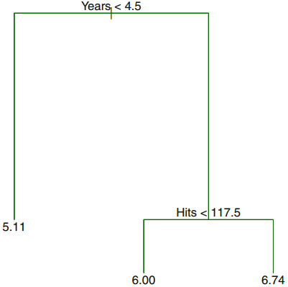
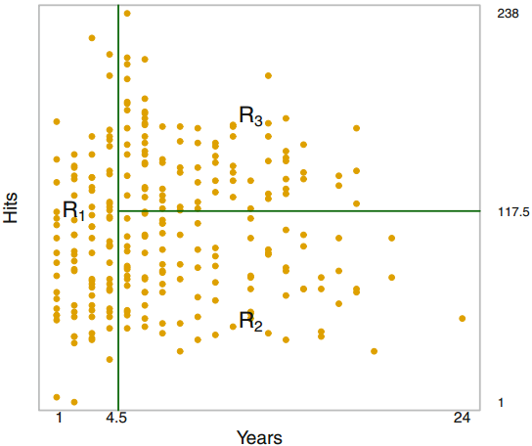
8.1.1 Regression Trees
Predicting Baseball Players’ Salaries Using Regression Trees
Some concept : terminal nodes, internal nodes, branches

Slide 5
Some concept
or leaves of the tree internal nodes branches.

Slide 6
Prediction via Stratification of the Feature Space
1. We divide the predictor space—that is, the set of possible values for X1, X2, . . . , Xp—into J distinct and non-overlapping regions, R1, R2, . . . , RJ.
2. For every observation that falls into the region Rj, we make the same prediction, which is simply the mean of the response values for the training observations in Rj.

Slide 7

How do we construct the regions R1, . . . , RJ?
In theory, the regions could have any shape. However, we choose to divide the predictor space into high-dimensional rectangles, or boxes, for simplicity and for ease of interpretation of the resulting predictive model. The goal is to find boxes R1, . . . , RJ that minimize the RSS, given by
Unfortunately, it is computationally infeasible to consider every possible partition of the feature space into J boxes. For this reason, we take a top-down, greedy approach that is known as recursive binary splitting.

Slide 8

we first select the predictor Xj and the cut point s such that splitting the predictor space into the regions {X|Xj < s} and {X|Xj ≥ s} leads to the greatest possible reduction in RSS.
Next, we repeat the process, looking for the best predictor and best cutpoint in order to split the data further so as to minimize the RSS within each of the resulting regions.
The process continues until a stopping criterion is reached; for instance, we may continue until no region contains more than five observations.

Slide 9
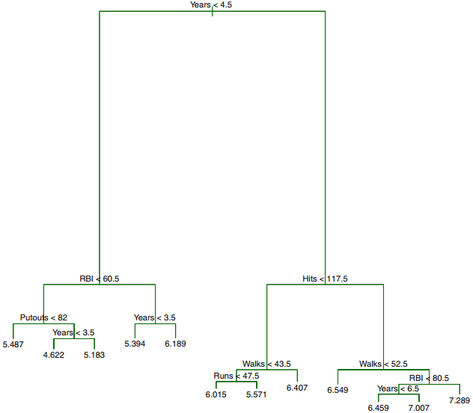

Slide 10
Tree Pruning
The process described above may produce good predictions on the training set, but is likely to overfit the data, leading to poor test set performance. This is because the resulting tree might be too complex.
A smaller tree with fewer splits (that is, fewer regions R1, . . . , RJ) might lead to lower variance and better interpretation at the cost of a little bias.

Slide 11
One possible alternative is to build the tree only so long as the decrease in the RSS due to each split exceeds some (high) threshold. A better strategy is to grow a very large tree T0, and then prune it back in order to obtain a subtree. Intuitively, our goal is to select a subtree that subtree leads to the lowest test error rate. Given a subtree, we can estimate its test error using cross-validation or the validation set approach. However, estimating the cross-validation error for every possible subtree would be too cumbersome, since there is an extremely large number of possible subtrees.

Slide 12

Cost complexity pruning
Rather than considering every possible subtree, we consider a sequence of trees indexed by a nonnegative tuning parameter α. For each value of α there corresponds a subtree T ⊂ T0 such that is as small as possible.
We can select a value of α using a validation set or using cross-validation. We then return to thefull data set and obtain the subtree corresponding to α.

Slide 13
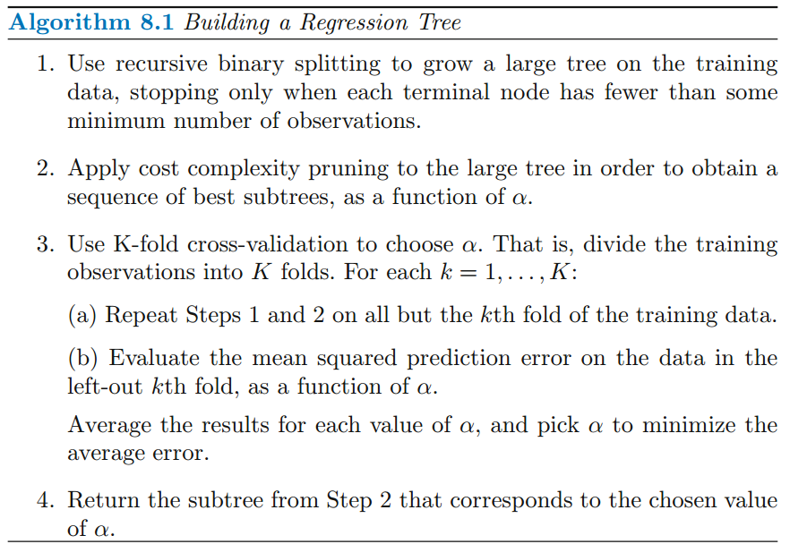

Slide 14
8.1.2 Classification Trees
A classification tree is very similar to a regression tree, except that it is used to predict a qualitative response rather than a quantitative one. For a classification tree, we predict that each observation belongs to the most commonly occurring class of training observations in the region to which it belongs.

Slide 15



Spliting Criterion
However, in the classification setting, RSS cannot be used as a criterion for making the binary splits. A natural alternative to RSS is the classification error rate.However, it turns out that classification error is not sufficiently sensitive

Slide 16
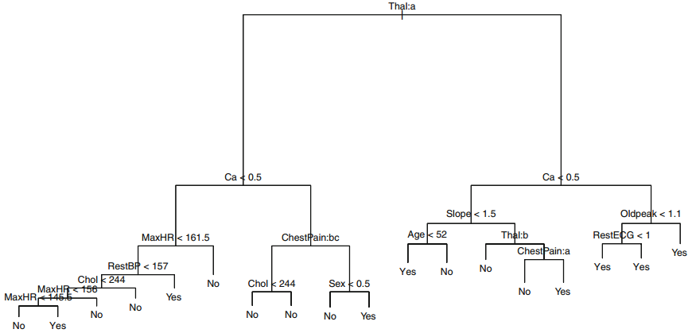

Slide 17
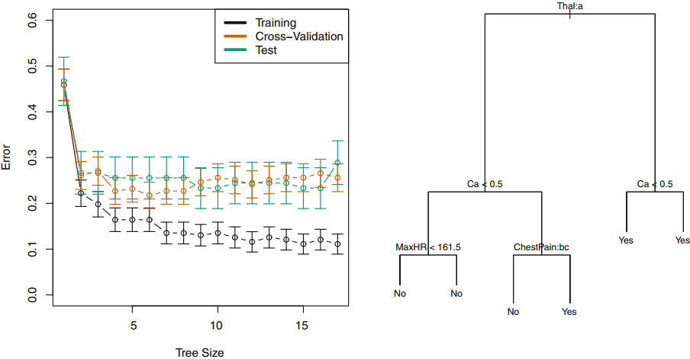

Slide 18


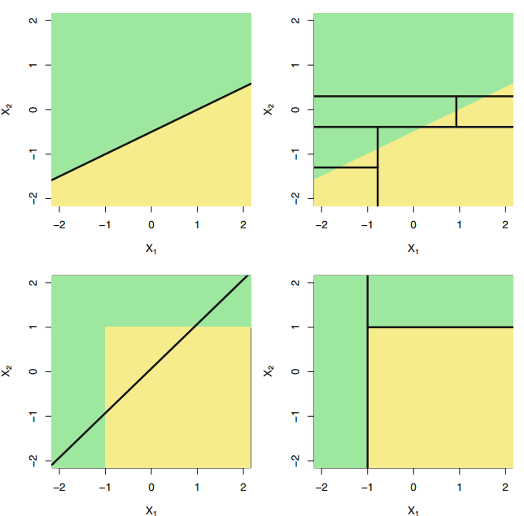
8.1.3 Trees Versus Linear Models

Slide 19

8.2 Bagging, Random Forests, Boosting 8.2.1 Bagging
Bootstrap aggregation, or bagging, is a general-purpose procedure for reducing the variance of a statistical learning method; we introduce it here because it is particularly useful and frequently used in the context of decision trees.

Slide 20
Out-of-Bag Error Estimation
It turns out that there is a very straightforward way to estimate the test error of a bagged model, without the need to perform cross-validation or the validation set approach. Recall that the key to bagging is that trees are repeatedly fit to bootstrapped subsets of the observations. One can show that on average, each bagged tree makes use of around two-thirds of the observations. The remaining one-third of the observations not used to fit a given bagged tree are referred to as the out-of-bag (OOB) observations. We can predict the response for the ith observation using each of the trees in which that observation was OOB.

Slide 21
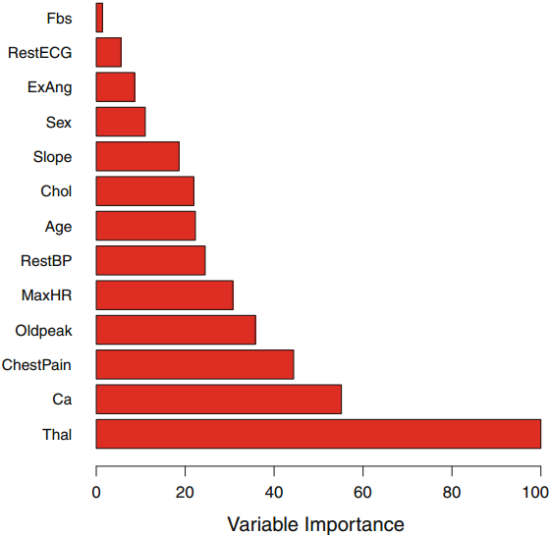
Variable Importance Measures
Although the collection of bagged trees is much more difficult to interpret than a single tree, one can obtain an overall summary of the importance of each predictor using the RSS (for bagging regression trees) or the Gini index (for bagging classification trees).

Slide 22
8.2.2 Random Forests
Random forests provide an improvement over bagged trees by way of a small tweak that decorrelates the trees. As in bagging, we build a number of decision trees on bootstrapped training samples.
But when building these decision trees, each time a split in a tree is considered, a random sample of m predictors is chosen as split candidates from the full set of p predictors. A fresh sample of m predictors is taken at each split, and typically we choose m ≈ √p—that is, the number of predictors considered at each split is approximately equal to the square root of the total number of predictors.

Slide 23
8.2.3 Boosting
Boosting works in a similar way, except that the trees are grown sequentially: each tree is grown using information from previously grown trees. Boosting does not involve bootstrap sampling; instead each tree is fit on a modified version of the original data set.

Slide 24
Fitting Classification Trees
rm(list=ls())
library (tree)
library (ISLR )
attach ( Carseats )
High= ifelse (Sales <=8 ," No"," Yes ")
Carseats = data.frame (Carseats , High)
tree.carseats = tree (High~.-Sales , Carseats )
summary (tree.carseats )
plot(tree.carseats )
text(tree.carseats ,pretty =0)
tree.carseats

Slide 25
Classification Trees (Training and testing)
rm(list=ls())
library (tree)
library (ISLR )
attach ( Carseats )
High= ifelse (Sales <=8 ," No"," Yes ")
Carseats = data.frame (Carseats , High)
set.seed (2)
train = sample (1: nrow( Carseats ), 200)
Carseats.test= Carseats [-train ,]
High.test =High[- train ]
tree.carseats =tree (High~.-Sales , Carseats , subset =train )
tree.pred = predict ( tree.carseats , Carseats.test ,type ="class")
table (tree.pred ,High.test)
(86+57) /200

Slide 26
Prune the tree(接上一页的tree.carseats)
set.seed (3)
cv.carseats = cv.tree(tree.carseats ,FUN = prune.misclass )
cv.carseats
prune.carseats = prune.misclass ( tree.carseats , best =9)
tree.pred = predict ( prune.carseats , Carseats.test , type ="class")
table ( tree.pred ,High.test)
(94+60) /200

Slide 27
Fitting Regression Trees
library (MASS )
set.seed (1)
train = sample (1: nrow ( Boston ), nrow( Boston )/2)
tree.boston = tree(medv~.,Boston , subset = train )
summary (tree.boston )
plot(tree.boston )
text(tree.boston , pretty =0)

Slide 28
Bagging
rm(list=ls())
library (randomForest)
set.seed (1)
train = sample (1: nrow ( Boston ), nrow( Boston )/2)
boston.test= Boston [-train ,"medv"]
bag.boston = randomForest( medv~., data= Boston , subset =train, mtry =13, importance =TRUE )
bag.boston
yhat.bag = predict (bag.boston , newdata = Boston [-train ,])
plot(yhat.bag , boston.test)
abline (0 ,1)
mean (( yhat.bag - boston.test)^2)
importance (bag.boston )

Slide 29
Random Forests
rm(list=ls())
library (randomForest)
set.seed (1)
train = sample (1: nrow ( Boston ), nrow( Boston )/2)
boston.test= Boston [-train ,"medv"]
rf.boston = randomForest( medv~., data= Boston , subset =train, mtry =6, importance =TRUE )
rf.boston
yhat.bag = predict (rf.boston , newdata = Boston [-train ,])
plot(yhat.bag , boston.test)
abline (0 ,1)
mean (( yhat.bag - boston.test)^2)
importance (rf.boston )

Slide 30
Boosting
rm(list=ls())
library (gbm)
set.seed (1)
train = sample (1: nrow ( Boston ), nrow( Boston )/2)
boston.test= Boston [-train ,"medv"]
boost.boston =gbm (medv~., data= Boston[train ,], distribution="gaussian",n.trees =5000 , interaction.depth =4)
summary ( boost.boston )
yhat.boost = predict (boost.boston , newdata = Boston [-train ,], n.trees =5000)
mean (( yhat.boost - boston.test)^2)

